Slide 1
Secure Data Hiding in Image Using Steganography
CAPSTONE PROJECT
Presented By: Sandeep Yadav
Student Name : Sandeep Yadav
College Name & Department : Mohanlal Sukhadia University (MLSU),Udaipur 313001 ,Rajasthan ,Vigyan Bhawan Block 'A'

Slide 2
OUTLINE
Problem Statement
Technology used
Wow factor
End users
Result
Conclusion
Git-hub Link
Future scope

Slide 3
Problem Statement
This project provides a simple implementation of **image-based steganography**,
where secret messages are hidden within an image
later retrieved using a decryption script.
The encryption and decryption processes involve modifying the pixel values of an image to store message bytes.

Slide 4
Technology used
Technology Used in This Project
Programming Language: Python
Easy to learn and widely used for image processing.
Libraries:
OpenCV (cv2): For image manipulation and processing.
NumPy: For numerical operations and handling arrays.
Pillow: For image file handling and manipulation.
Platforms:
Operating System: Windows OS
Compatible with various Python libraries and tools.

Slide 5
Wow factors
Enhanced Security:
Utilizes advanced algorithms for data encryption before embedding, ensuring data is not easily detectable.
User -Friendly Interface :
Simple GUI for users to easily upload images and data files for embedding.
Multiple Formats :
Supports various image formats (JPEG, PNG, BMP) for flexibility.
Real-Time Processing :
Fast embedding and extraction processes, allowing for real-time applications.
Steganalysis Resistance :
Incorporates techniques to minimize the risk of detection by steganalysis tools.
Banking Factor Secure Financial Transactions:
The project can be applied to secure sensitive banking information, such as account details and transaction data, by embedding them within images. This ensures that even if the data is intercepted, it remains hidden and protected.

Slide 6
End users
Individuals:
People looking to securely share sensitive information (e.g., personal data, passwords).
Businesses:
Companies needing to protect confidential documents and communications.
Researchers:
Academics and professionals in cybersecurity and data protection fields.
Government Agencies:
Organizations requiring secure communication channels for sensitive information.

Slide 7
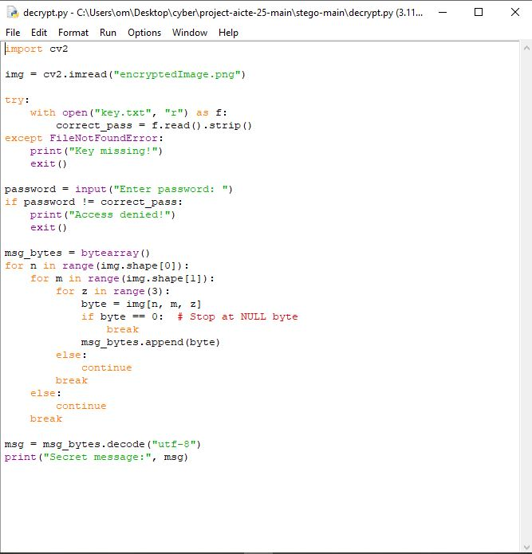
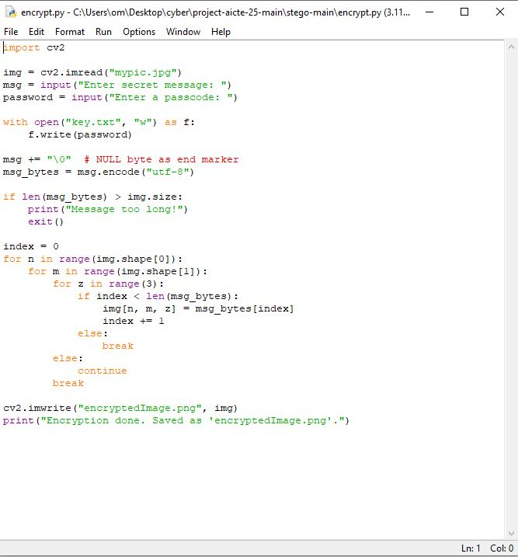
Results
2. Input of decrypt
1. Input of encrypt

Slide 8
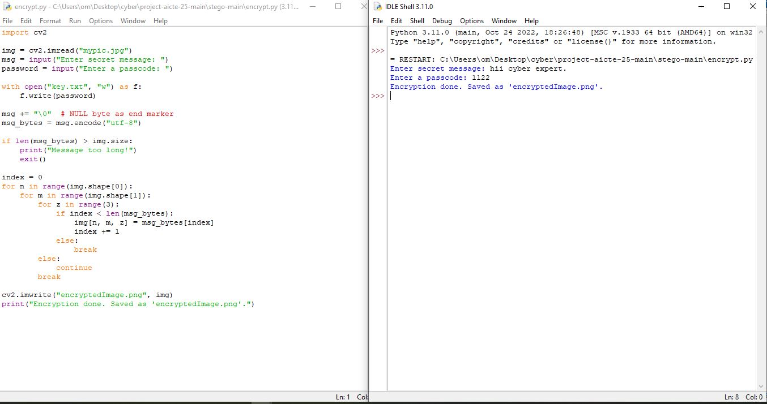
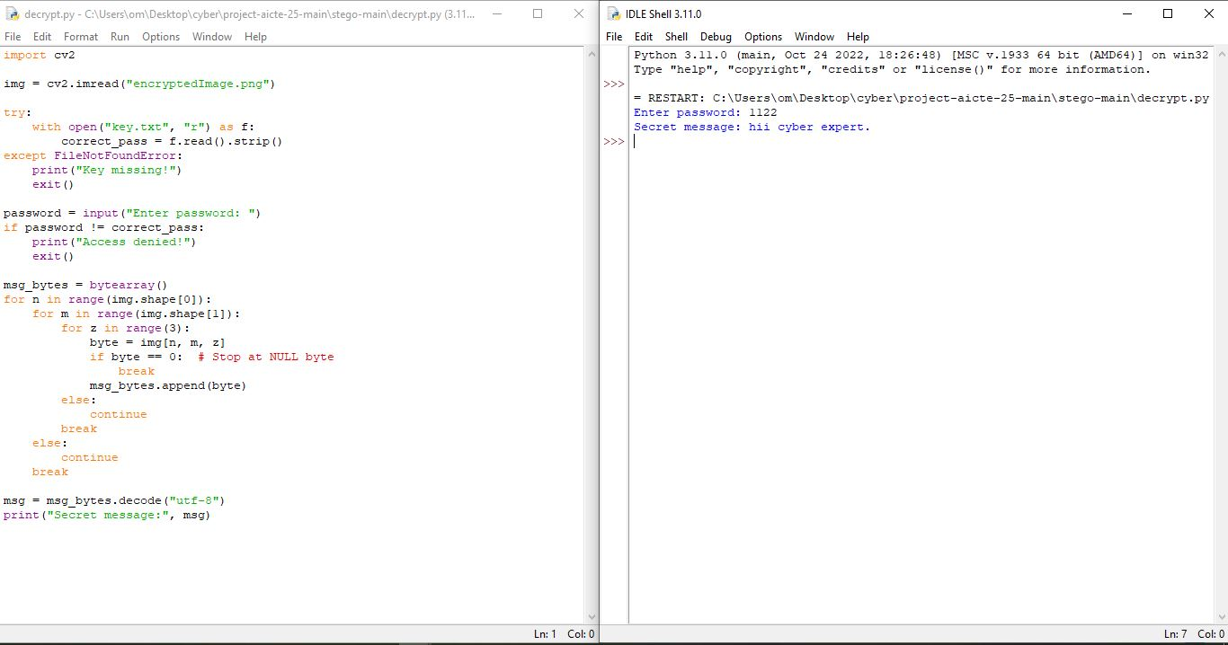
3. Output of encrypt
4. Output of decrypt

Slide 9
Conclusion
Summary:
This project demonstrates a robust method for securely hiding data within images using steganography techniques. By leveraging Python and OpenCV, we can ensure that sensitive information is concealed effectively while maintaining the integrity of the host image.
Problem Statement:
In an era where data breaches are common, the need for secure data transmission is paramount. This project addresses that need by providing a reliable solution for data hiding.

Slide 10
GitHub Link
https://github.com/sandeepyadav08/Steganography

Slide 11
Future scope(optional)
Improved Algorithms:
Research and implement more advanced steganography algorithms for better security and efficiency.
Cross-Platform Compatibility:
Develop versions for other operating systems (Linux, macOS) to reach a wider audience.
Mobile Application:
Create a mobile app version for on-the-go secure data sharing.
Integration with Blockchain:
Explore the potential of combining steganography with blockchain technology for enhanced security and traceability.
User Education:
Develop tutorials and resources to educate users on the importance of data security and how to use the tool effectively.

Slide 12
THANK YOU

